Slide 1
VGG Model on CIFAR-10 Database
Sara AL SAYYED Hadi HOUSSAINY

Slide 2
Table of Contents
01
02
03
04
Baseline Model
The architecture of baseline model and the result
VGG16 Model
VGG16 Model Architecture
Results on CIFAR 10
Comparison
Compare between the baseline model and VGG16 models
Conclusion

Slide 3
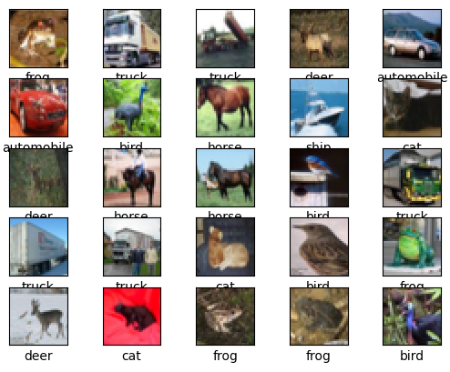
CIFAR-10 Dataset
Collection of 60,000 tiny images (32x32 pixels) labeled across 10 object classes.
Commonly used for training image recognition models, it's a well-established benchmark in computer vision research.
We are using 90% of the images for training and 10% for testing.

Slide 4
01
Baseline Model

Slide 5
Baseline Model
3 Convolutional layer: all with (3,3) kernel size and RELU activation.
2 Max-pooling Layer
2 Fully Connected Layers: The first one is with RELU activation function and the last is with SOFTMAX function that output 10 classes.
71 % accuracy on the testing set

Slide 6
02
VGG16 Model

Slide 7
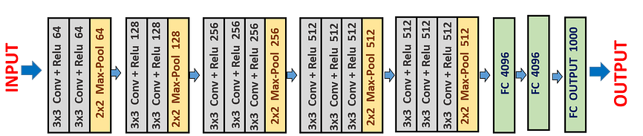
VGG 16 Architecture
Number of Convolutional Layers : 13
Number of Max pooling Layer : 5
Number of Fully Connected Layers: 3
Kernel Size: 3x3

Slide 8
Batch Size
Batch: A subset of the dataset containing a fixed number of data samples.
The batch size determines the number of dataset samples utilized to calculate the error gradient and adjust the model parameters in each training iteration.
The phenomena is called Mini-Batch gradient descent.

Slide 9
VGG 16 on CIFAR 10
Modified the input layer of VGG16 to accept images of size: 32 x 32 x 3
Replaced all fully connected layers with new ones.
Added output layer of 10 (classes).
Batch Size | 128 | 50 | 32 | 18
Accuracy | 68% | 68% | 72% | 73%

Slide 10
03
Results Comparison

Slide 11
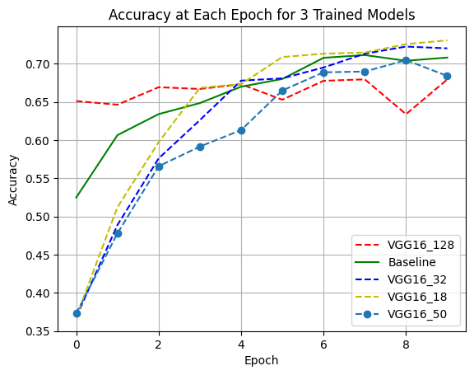
Results Comparison
What Could have happened?
With batch size:
Reduced variance in gradient estimates
Escaping local minima
Better generilization

Slide 12
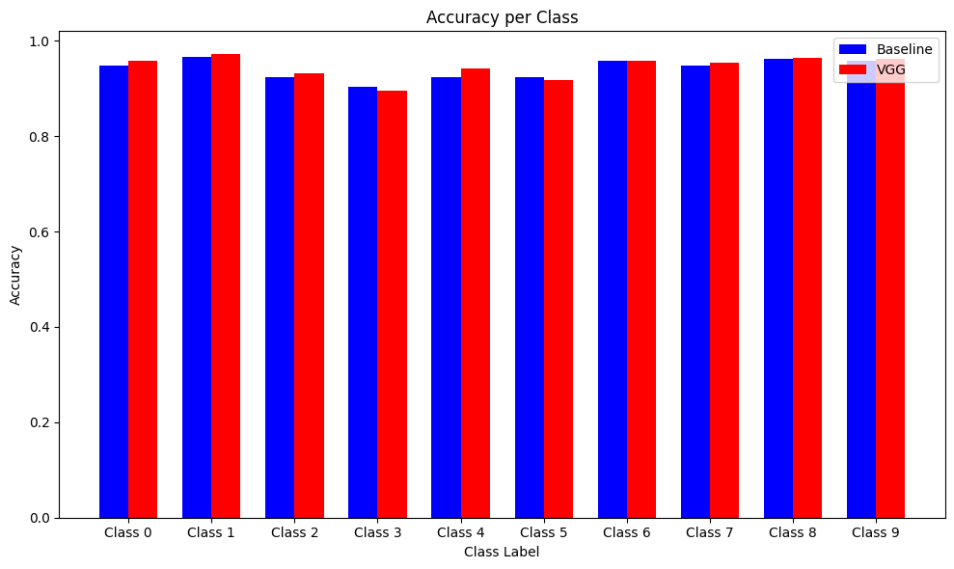
Results Comparison
We compare the accuracy of the baseline model and the VGG16 with batch size=18 for each class.
We notice that there is a very slight difference between the two

Slide 13
04
Conclusion

Slide 14
Conclusion
Our findings indicate that for the CIFAR-10 database, employing the VGG model heightens complexity without yielding a noteworthy accuracy enhancement.
Consequently, opting for the baseline model may prove to be a superior choice.

Slide 15
THANK YOU!!

